Slide 1



Aviation Accident dashboard
View in Power BI
Last data refresh:
3/14/2018 2:47:23 PM South Africa Standard Time
Downloaded at:
3/14/2018 2:54:14 PM South Africa Standard Time

Slide 2
BACKGROUND
The data set used is from Kaggle.com, Data set consists of Aviation accidents report database
The information reported on is from Year 2000 – 2017
The Visualization was created using Power BI

Slide 3
BACKGROUND :Questions
With the project, I tried find answers and understand the following questions and factors that might have contributed to aircrafts incidents.
Number of injured people in year 2000-2017 ?
What was the purpose of flight with fatal injuries ?
How many people were injured compared to uninjured during aircraft damages ?
Was weather conditions an impact to accidents ?
Top 10 aircraft with most accidents ?
Which country has most accidents ?

Slide 4
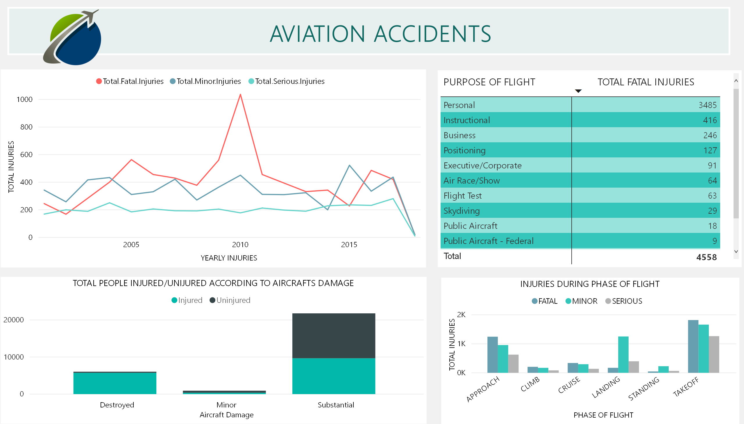

Slide 5
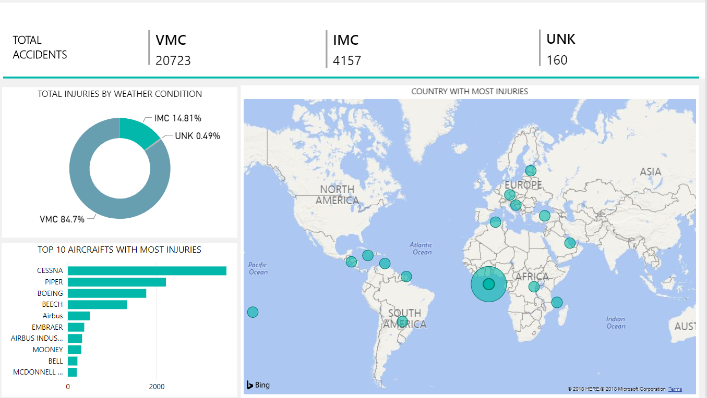

Slide 6
RESULTS
From the findings it shows that more people were injured from the aircraft were the damage was substantial and also showed and overall findings that people were also likely not to get injured where the aircrafts was substantial damaged
People were likely to get injured where the flight damage was destroyed and had less chance of survival
People travelling on CESSNA, Piper and Boeing for personal use had more chances to get injured as the findings shows that the were more injuries for above mentioned aircrafts
The were less accidents on UNK(Bad/dangerous weather conditions) as aircrafts usually gets cancelled on this weather
United states had more accidents than the other country E.g There is more chance of injury travelling in United State with a CESSNA or Piper for personal flights than travelling in IMC

